Slide 1
Lucia A. Pirisi-Creek, MD, Principal Investigator
Edie Goldsmith, PhD, Program Coordinator
Kiona Thomas, MS, Program Manager
Institutional Program Leaders/Steering Committee members:
USC: Dr. Wayne Carver MUSC: Dr. Roger Markwald Clemson University: Dr. Martine LaBerge
Furman University: Dr. John Wheeler Converse College: Dr. Neval Erturk
College of Charleston: Dr. James Deavor Winthrop University: Dr. Robin Lammi
Claflin University: Dr. Angela Peters SC State University: Dr. Judith Salley
Presbyterian College: Dr. Scott Asbill Coastal Carolina University: Dr. Paul Richardson USC Aiken, Dr. William Jackson Francis Marion University: Dr. Ann Stoeckmann
Bioinformatics Core: Dr. Homayoun Valafar

Slide 2
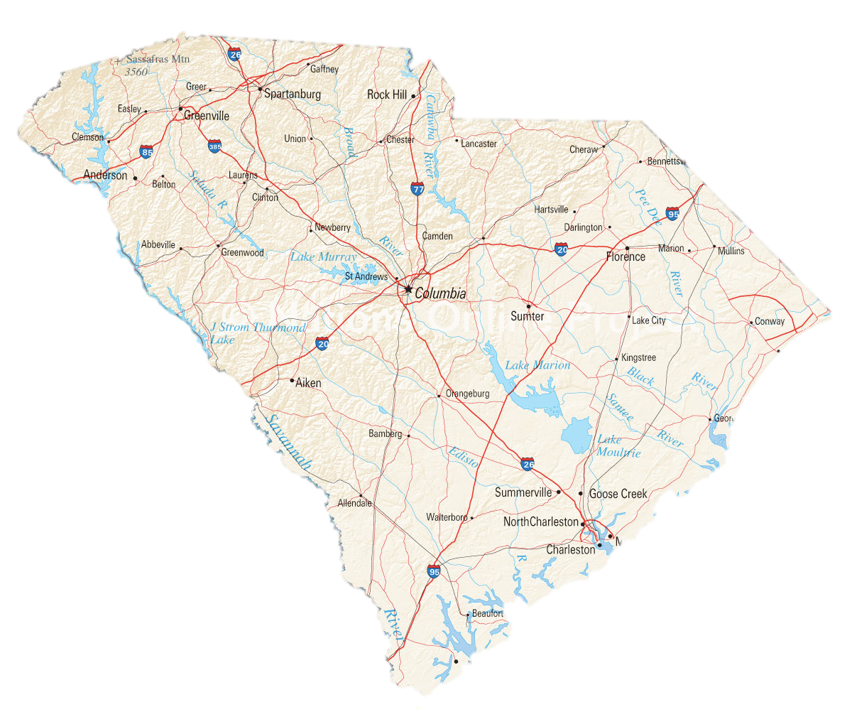
Furman U Converse C
Winthrop U
Clemson U
Presbyterian C
Anderson U
Benedict College
Francis Marion U
Lander U
USC
Coastal Carolina U
USC Aiken
Claflin U SCSU
>30% Minority Students
HBCU
Outreach PUI
MUSC
Continuing Network PUI
New Network PUI
CRU
CofC
USC Beaufort

Slide 3
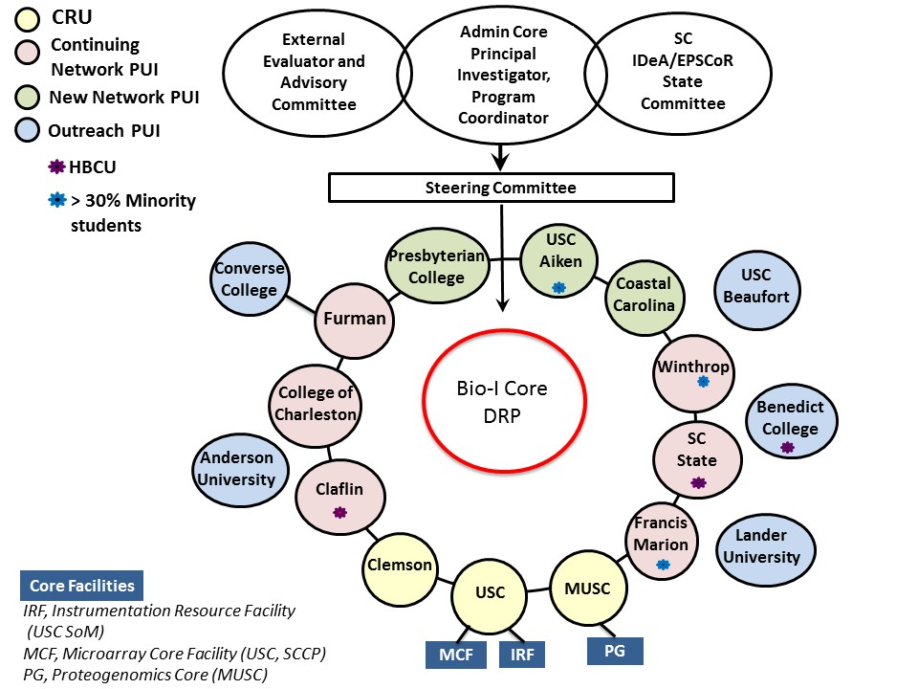
K-12 outreach

Slide 4
SC INBRE I
Stem Cell Core facility, MUSC
Proteogenomics facility, MUSC
Instrumentation Resource Facility (IRF), USC School of Medicine
SC INBRE II
NMR facility, Claflin University
Proteogenomics Facility, MUSC
Microarray Core Facility (MCF), USC
IRF, USC School of Medicine
Biomedical Engineering Core, USC
SC INBRE III
Proteogenomics Facility, MUSC
Microarray Core Facility, USC
IRF, USC School of Medicine
Biomedical Engineering Core, USC
Infrastructure building: animal facilities (Converse College; Presbyterian College) biological sample prep lab for NMR facility (Claflin University)

Slide 5
SC INBRE Support of Core Facilities
Models for core facility support within SC INBRE:
Direct, infrastructure-building support (examples: MUSC Stem Cell Core; Claflin NMR facility; USC Biomedical Engineering Core)
Direct support, targeted to specific needs within one institution
(example: confocal microscope at USCB, SC INBRE II)
Direct support, targeted to specific programs/events
Indirect support, through project funding
2) Role of INBRE-supported core facilities in research training
networking and access to scientific resources
formal workshops
facility tours for groups of students (i.e.: from PUIs)
visits to PUI campuses by core facility directors
direct, hands-on training experiences for students

Slide 6
Claflin University: NMR Facility
700 MHz NMR acquired with DoD support
Space construction/renovation and outfitting: Claflin University
Joint SC INBRE II/EPSCoR support for personnel:
Dr. Arezue Boroujerdi: SC INBRE hire and target faculty, SC INBRE II
Dr. Raj Bhaskaran (NMR Facility Director until 2014)
a postdoctoral fellow
a full time technician
SC INBRE III partially funds the renovation of space in the NMR facility for a biological sample prep lab (ongoing)
Other than the A&R contribution listed above, the Claflin NMR facility is now independent of SC INBRE support

Slide 7
Claflin NMR Facility Clients from South Carolina (linked to SC INBRE)
Dr. John Dawson, University of South Carolina
Dr. Caryn Outten, University of South Carolina
Dr. Homayoun Valafar, University of South Carolina (Bio-I Core)
Dr. Nick Grossoheme, Winthrop University (TF)
Dr. Heather Evans Anderson, Winthrop University (former TF)
Dr. Sondra Berger, University of South Carolina
Dr. Angela Peters, Claflin University (institutional PI)
Dr. Michael Sehorn, Clemson University
Dr. Erin Eaton, Francis Marion University (TF)
Dr. Karen Buchmuller, Furman University (TF)
Dr. Marcello Forconi, College of Charleston (TF)
Dr. Esmaeil Jabbari, University of South Carolina (TF)
Dr. Scott Argraves, MUSC (PGF Director)
From: Dr. Raj Bhaskaran, Clemson CI Symposium - Feb 13, 2013
Notes:
7
No meat rice story

Slide 8
NMR Facility clients outside of South Carolina:
The University of Missouri, Columbia, MO
University of Illinois College of Medicine, Rockford, IL
University of Arkansas, Fayetteville, AR
University of Madras, Chennai, India
Seattle Biomed, Seattle, WA
From: Dr. Raj Bhaskaran, Clemson CI Symposium - Feb 13, 2013
Notes:
8
No meat rice story

Slide 9
Hands-on training at the NMR facility, Claflin University
2011: 2 undergraduate students
2012: 9 trainees
7 undergraduate students; 1 graduate student;
1 postdoctoral associate
2013: 12 trainees
10 undergraduate students; 2 graduate students
2014: 19 trainees
14 undergraduate students; 4 graduate students; 1 staff

Slide 10
Role of Core Facilities in Research Training
Core facilities provide training in the utilization of equipment and techniques to students and other scholars, through:
Summer REU programs
Formal courses/workshops
Project-specific training as a part of SC INBRE-funded project
Guided tours and demonstrations

Slide 11
MUSC Proteogenomics Facility REU
Organized in conjunction with the general MUSC Summer Research Experience for Undergraduate Students
One or two students per year, selected by a competitive process
Students come from any PUI in the state, URM students are strongly encouraged to participate
8-week hands-on training in genomics and bioinformatics, culminating in a poster presentation at local symposium
Publication and other presentations possible, depending on student performance and nature of project

Slide 12
Workshop sees 30 - 50 participants annually, from SC and beyond.
In 2015: 33 participants from 5 US states and two foreign countries (Austria and Nigeria)
Invited keynote speakers present daily seminars complementing workshop activities
5 full days of hands-on training from specimen preparation and processing, to confocal imaging, to data analysis, under direct guidance from instructors
Participants work with provided cell/tissue samples or bring their own samples to process: therefore, at the end of the workshop, participants may have conducted an entire experiment on their own materials
Co-supported by COBRE and INBRE funds and co-sponsored by host institution
Industry participation/support

Slide 13
Training as a part of SC INBRE funded projects (i.e.: Bioinformatics Pilot Projects and USC MCF/MUSC Proteogenomics facilities)
Core facility personnel provide one-on-one support and training to students involved in SC INBRE projects
Core co-directors/managers work personally with investigators and their students to develop and conduct research projects
All Bioinformatics Pilot Projects that make use of these core facilities must include a letter of support from core directors

Slide 14
Additional considerations/challenges
Sustainability: how much self-support is reasonable, and what is the true cost of self-support?
Core facility utilization by PUI faculty and students
Tracking of students that receive training at core facilities

